Slide 1

Introduction to data warehousing
MTN.BI.07
Introduction to Data Warehousing
Elias Nema
Lead Software Engineer
Elias_Nema@epam.com

Slide 2
Agenda
The origin of the Data Warehousing
Transactional vs. Data Warehousing
Why Oracle

Slide 3
The origin of the Data Warehousing

Slide 4
Business Intelligence
In 1958 IBM Research Fellow Hans Peter Luhn wrote:
BI is the ability to apprehend the interrelationships of presented facts in such a way as to guide action towards a desired goal.
In 1993 Gartner Analyst Howard Dresner:
Concepts and methods to improve business decision making by using fact-based support systems.

Slide 5

Roots

Slide 6
Evolution leading up to the data warehouse
Automation
Data-entry applications
Controlling
Control and make basic decisions (inventory managing)
Informative
Fixed presentation of data => Executive Information Systems (EIS)
Notes:
The computer evolution leading up to the data warehouse progressed through three basic steps in application development.
The first applications implemented were for the automation of mundane tasks. Most of these systems were data entry applications that used a keyboard and a text-only, normally green, display screen.
During the second step, after these tasks were automated, computers were used to control and make basic decisions. These applications still used the text-only green screens, but were used to manage, control, or change something in the business. Inventory management is a good example of a controlling application because it is not data entry but is still process-centric.
The third step in application development entailed a fixed type of data presentation. This fixed presentation was informative but basically only displayed the data in the database. This data had been captured from the first two, functionally focused computer system implementations. Sometimes the data was summarized but remained primarily organized and used in the exact same way as in the functional systems. Originally, the data presentations used only the green text-only screens, but they soon began to utilize color screens. If they were "really advanced," they could display bar graphs. These latter systems were often called executive information systems (EIS). All three of these systems were time-critical on-line transaction processing (OLTP) systems that required from the computer a very fast, normally subsecond, response time. The people that used these systems expected a fast response time, too.

Slide 7

Liebowitz Pyramid
Intelligence
Knowledge
Information
Data
Notes:
Data is defined as numerical or other facts represented or recorded in a form suitable for processing by computers.
Information is data, processed to something meaningful. By processing, summarizing or analyzing data, organizations create information. For example the current balance, items sold, money made etc. Information is processed data so that it becomes useful and provides answers to questions such as "who", "what", "where", and "when".
Knowledge, on the other hand is an application of information. It gives insights by answering the “how” questions.
Intelligence is appreciation of "why", and finally wisdom is the application of intelligence and experience toward the attainment of common goals, and wise people are powerful.

Slide 8
To put it simply…
Remember:
Transaction Databases are designed to get data IN.
Analytical Databases are designed to get information / knowledge / intelligence OUT.

Slide 9
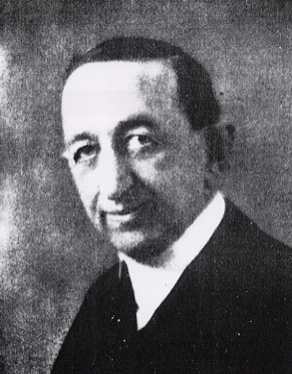
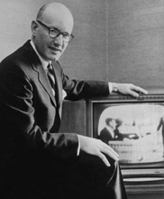
Forefathers
The continuous marketing research conducted by Charles Coolidge Parlin (1872–1942) (he is now recognized as the Father of Marketing Research). He did marketing research for the Curtis Publishing Company to gather information about customers and markets to help Curtis sell more advertising in their magazine, The Saturday Evening Post.
In 1923 Arthur Nielsen established ACNielsen. Among many innovations in consumer-focused marketing and media research, Mr. Nielsen created a unique retail-measurement technique that gave clients the first reliable, objective information about competitive performance and the impact of their marketing and sales programs on revenues and profits.

Slide 10

60s

Slide 11
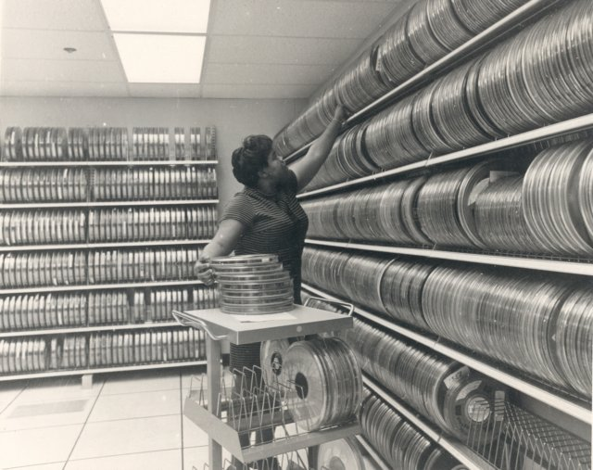
But what was happening in the computing world?
The world of computation consisted of applications that were executed on master files which were stored on magnetic tapes, which were good for storing a large volume of data cheaply, but had the drawback of needing to be accessed sequentially, and being very unreliable.

Slide 12
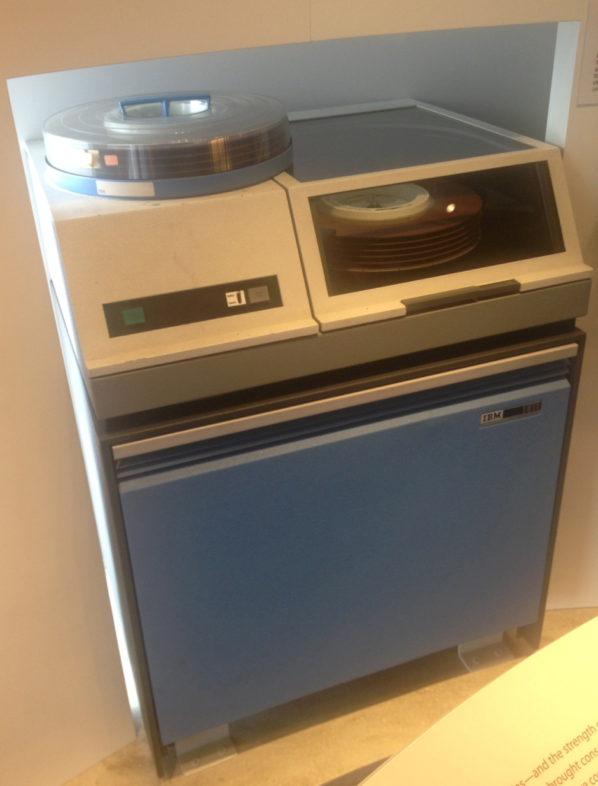
Navigational DBMS
Even though HDD was already invented (1956), it wasn’t widely in use. However it allowed to build first database systems. The term represented a contrast with the tape-based systems of the past, allowing shared interactive use rather than daily batch processing.
Those were navigational databases. Data usually was linked together by using pointers, which told the DBMS software the location of the next logical piece of data or the previous piece of data.

Slide 13
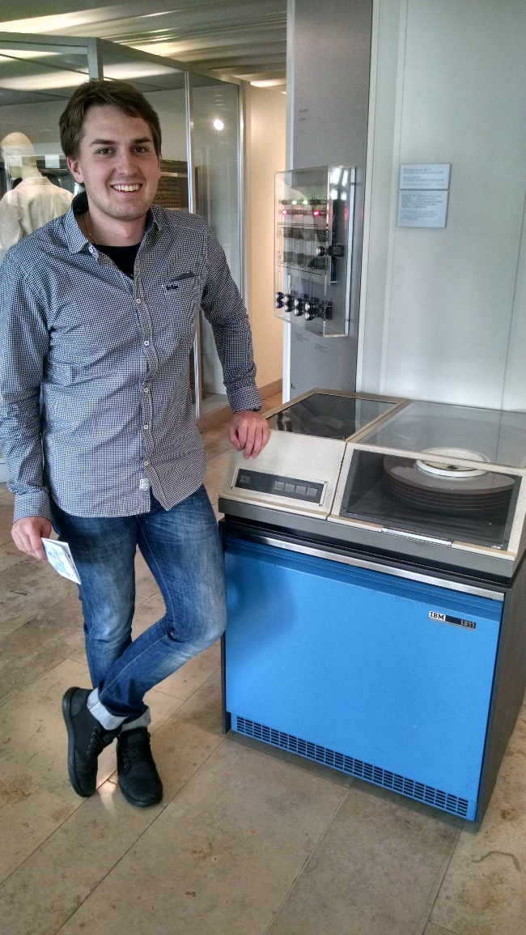
62’s IBM 1311 & Max

Slide 14
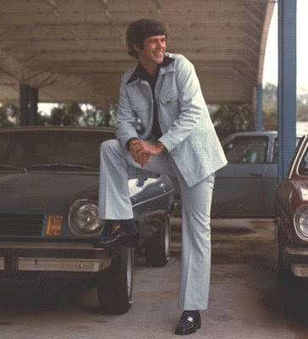
70s

Slide 15
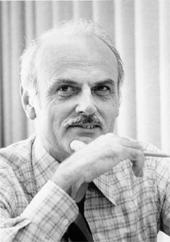
Dr. Codd
Edgar Codd worked at IBM in and was primarily involved in the development of hard disk systems. He was unhappy with the navigational model. In 1970, he wrote a number of papers that outlined a new approach to database construction that eventually culminated in the A Relational Model of Data for Large Shared Data Banks.

Slide 16

Relational DBMS
The relational model was much easier to understand, and SQL, the language used to access the database, did not require knowledge of how the underlying data was physically stored. It became much easier to build applications, which led to widespread use of database management systems.
In 1979, the Oracle database became the first commercially available relational system.

Slide 17

80s

Slide 18

OLTP Golden Age
As relational databases matured in the 1980s OLTP (OnLine Transactional Processing) systems were built using relational systems to automate the operational aspects of the business.
During this time, the relational database vendors focused on improving performance for OLTP applications and competed with each other using industry standard TPC-C benchmarks.

Slide 19

Data Warehouse. The Beginning.
In 80s a group of enterprising, forward-thinking people came up with a new idea: Because data is located all over the place, why not create special software to enable people to make a request at a PC or terminal, such as “Show per-store sales in all worldwide regions, ranked in descending order by improvement over sales in the same period a year earlier”

Slide 20
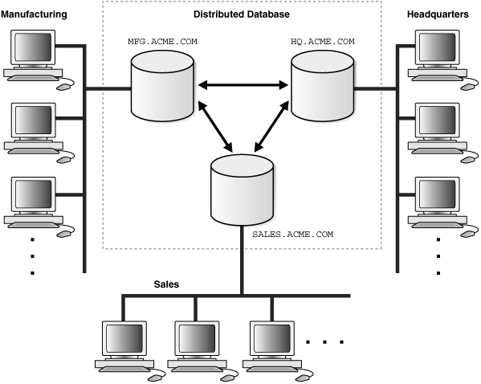
DDBMS
The new type of software (DDBMS), would magically pull the requested data from databases across the organization, bring all the data back to the same place, and then consolidate it, sort it, and do whatever else to answer the user’s question.

Slide 21



Data Warehouse. The Origin.
The concept of DDBMSs was a good one and early results from research were promising, the results were plain and simple: They just didn’t work in the real world. Also, the islands-of-data problem still existed.
So people started trying to solve that problem.
Teradata began shipping commercial products to solve this problem. Wells Fargo Bank received the first Teradata test system in 1983, a parallel RDBMS for decision support — the world’s first.
Ralph Kimball founded Red Brick Systems in 1986. Red Brick began to emerge as a visionary software company by discussing how to improve data access.
In 1988, Barry Devlin and Paul Murphy of IBM Ireland introduced the term business data warehouse as a key component of the Europe/Middle East/Africa Business Information System.

Slide 22
90s. Data Warehouse. Back to the Future.
If the 1980s approach of reaching out and accessing data directly from the files and databases didn’t work, the 1990s philosophy involved going back to the 1970s method, in which data from those places was copied to another location — only doing it right this time.
Data Warehouse
East
North
West

Slide 23
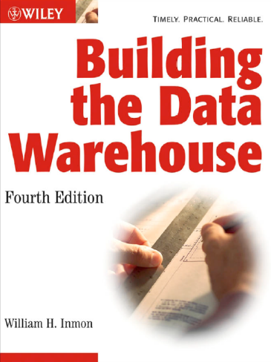
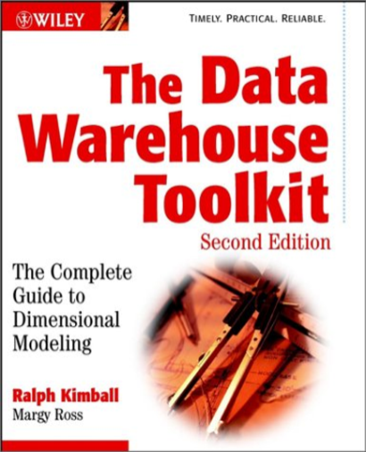
Data Warehouse. The Birth.
In 1993, Bill Inmon wrote Building the Data Warehouse. Many people recognize Bill as the Father of Data Warehousing. Additional publications emerged, including the 1996 book by Ralph Kimball, The Data Warehouse Toolkit, which discussed general-purpose dimensional design techniques to improve the data architecture for query-centered decision support systems.

Slide 24
2000s and Present Days

Slide 25
And it keeps growing

Slide 26

Data Warehouse Is a Tool
The reason to build a Data Warehouse is to have the ability to make better decisions faster based on information using current and historic data.
You should be obsessed to provide business value to the company, not to stick any methodology.

Slide 27
WHY oracle

Slide 28
Oracle is #1 for Data Warehousing
Data is for 2013

Slide 29

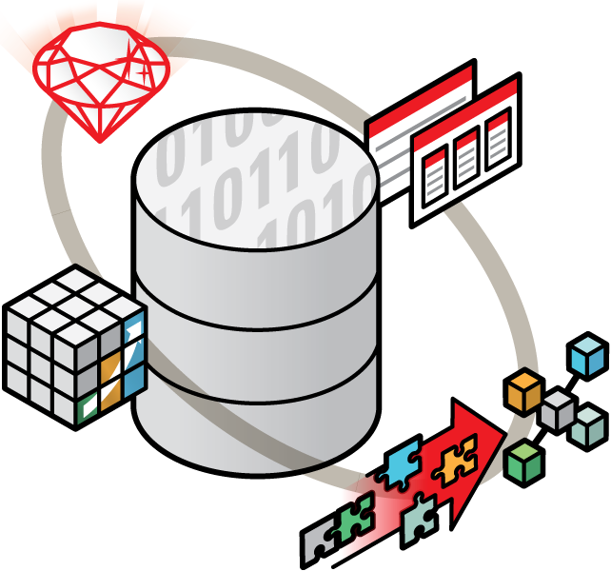
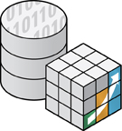


Oracle Database
Data
Marts
Online
Analytics
ETL
Data Mining

Slide 30
Introduction to Data Warehousing
Elias Nema
Lead Software Engineer
Elias_Nema@epam.com

